Slide 1
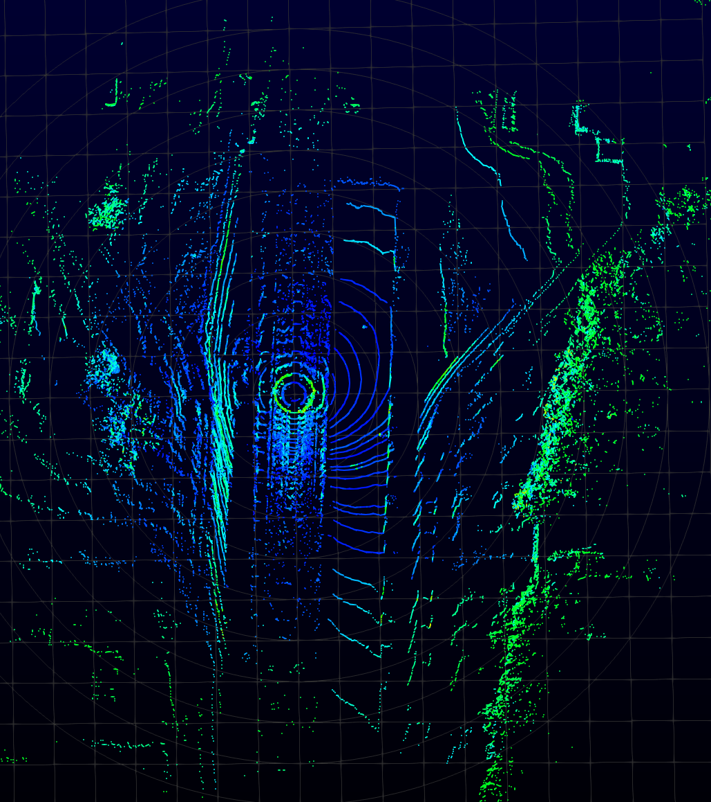
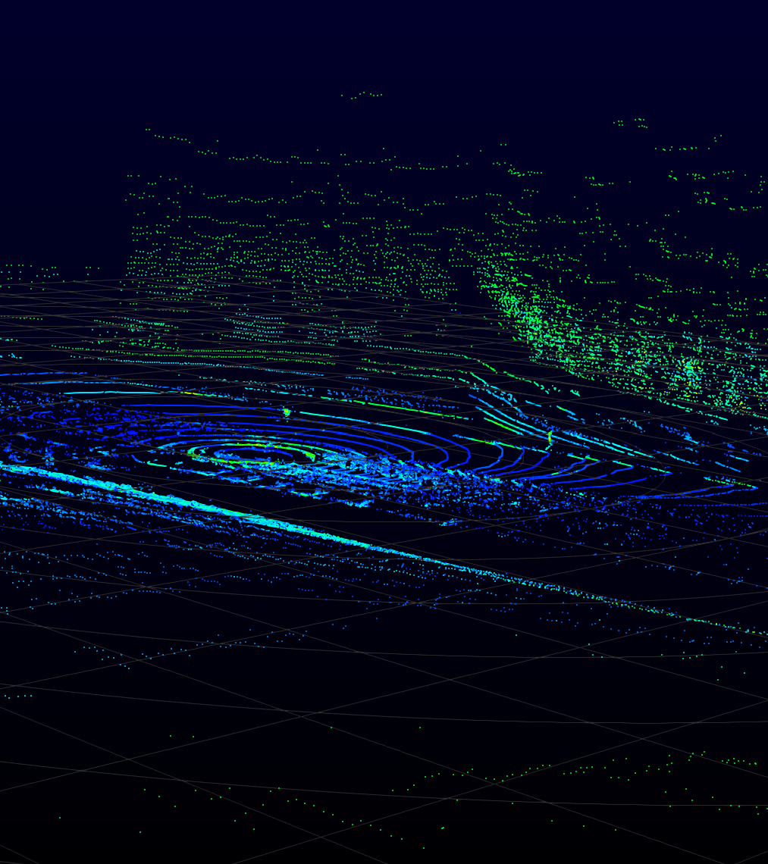

Slide 2

1 Frame Per Second (30 Frames)
2 Frames Per Second (30 Frames)

